Slide 1
FOUNDATIONS OF
AI APPLICATIONS
PROJECT : SPEECH TO TEXT
Submitted to: dR. PRASHANT UPADHYAYA
SUBJECT CODE: 20ECP-118

Slide 2
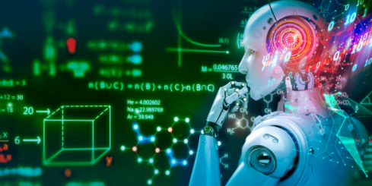
Group 1:
BE CSE 20CC1_B
ABHINAV SINGH : 20BCS4126
MILIND PAL SINGH TANWAR : 20BCS4117
NAVNEET GUPTA : 20BCS4148

Slide 3

SPEECH TO TEXT PROJECT
TOPIC
We have performed Speech-to-Text conversion using pre-trained Machine Learning API Models for Short-form or Long-form Audio

Slide 4
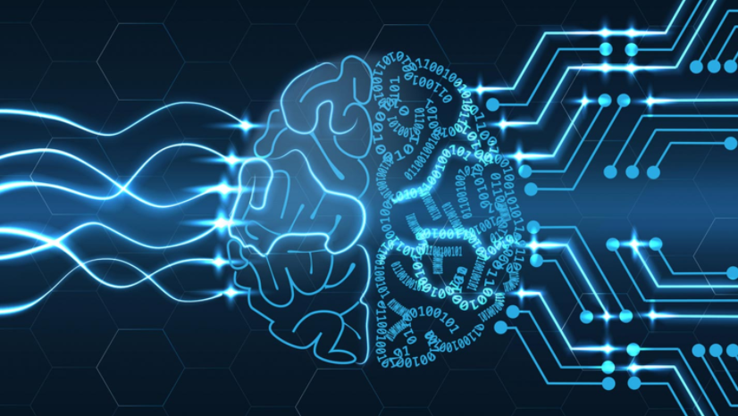
Software used: Python 3.8.6 Shell (64-bit)
Libraries installed:
“PyAudio” library :
(pip install pipwin, pip install pyaudio)
The Python package audiofile handles all kind of audio files with a focus on audio speed.
“Speech Recognition” library:
(pip install SpeechRecognition)
Recognize speech input from the microphone

Slide 5
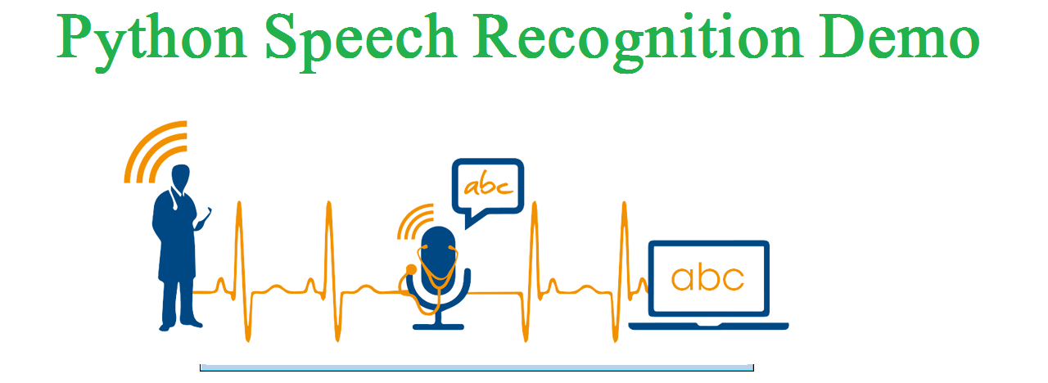
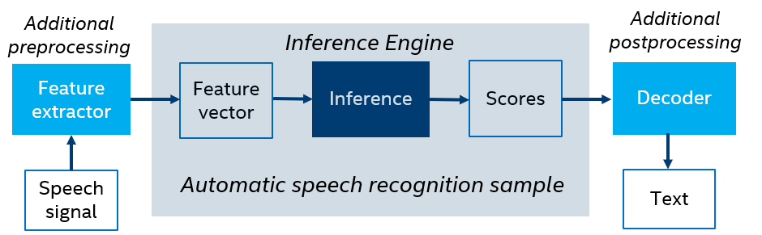
Theory
Speech recognition in Python

Slide 6
CODE:
# Python program to translate speech to text
import speech_recognition as sr
# Initialize the recognizer
r = sr.Recognizer()
# Loop infinitely for user to speak
text_length=0
# It will going to continue run until it count the text length less than 20.
while(text_length<50):
# Exception handling to handle exceptions at the runtime
try:
# use the microphone as source for input.
with sr.Microphone() as source2:

Slide 7
# wait for a second to let the recognizer adjust the energy threshold based on the surrounding noise level
r.adjust_for_ambient_noise(source2, duration=0.2)
#listens for the user's input
audio2 = r.listen(source2)
# Using google to recognize audio
MyText = r.recognize_google(audio2)
MyText = MyText.lower()
print("Message: \n"+MyText)
text_length=len(MyText)
print("Message length: ",text_length)
except sr.RequestError as e:
print("Could not request results; {0}".format(e))
except sr.UnknownValueError:
print("unknown error occured")

Slide 8
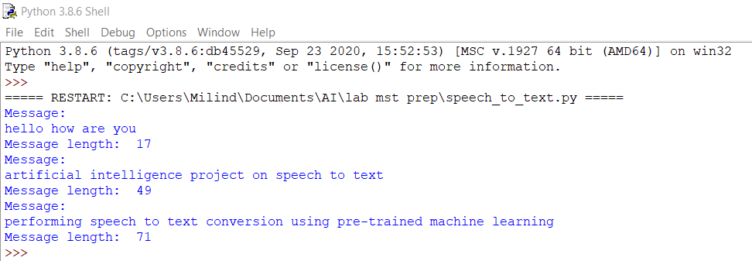
OUTPUT:

Slide 9

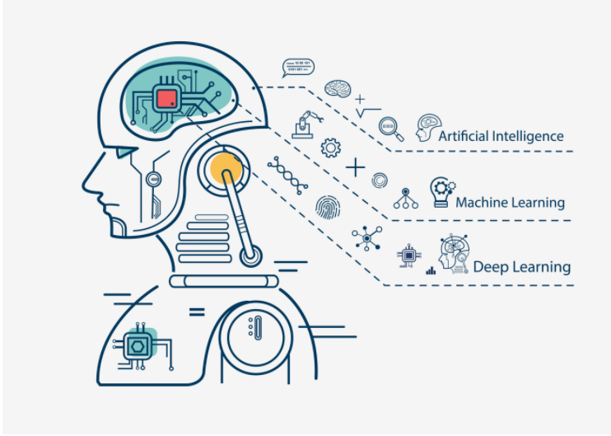
Usage in education and daily life
People with disabilities
Telephony and other domains
Hands-free computing: Speech recognition computer user interface
Home automation
Interactive voice response
Mobile telephony, including mobile email
Multimodal interaction
Pronunciation evaluation in computer-aided language learning applications
Robotics
APPLICATIONS

Slide 10

THANK YOU

